Slide 1
Introduction to Classes (CS 217)
Mr. Jawad Hassan,
Department of Computer Science,
National University of Computer & Emerging Sciences, Islamabad Campus

Slide 2
1. Contac Information
Introduction to Classes
Procedural and Object-Oriented Programming, Introduction to Classes, Defining an Instance of a Class, Why Have Private Members?, Separating Class Specification from Implementation, Inline Member Functions, Constructors, Passing Arguments to Constructors, Destructors, Overloading Constructors, Private Member Functions, Arrays of Objects, Creating an Abstract Array Data Type, Finding the Classes and Their Responsibilities
7 Lectures (1 Hour /lec)

Slide 3
Why Objects?

Slide 4
But binary is hard (for humans) to work with…

Slide 5
Notes:
Declarative programming is where you say what you want without having to say how to do it. With procedural programming, you have to specify exact steps to get the result. For example, SQL is more declarative than procedural, because the queries don't specify steps to produce the result.
ML ("Meta Language") is a general-purpose functional programming language.

Slide 6
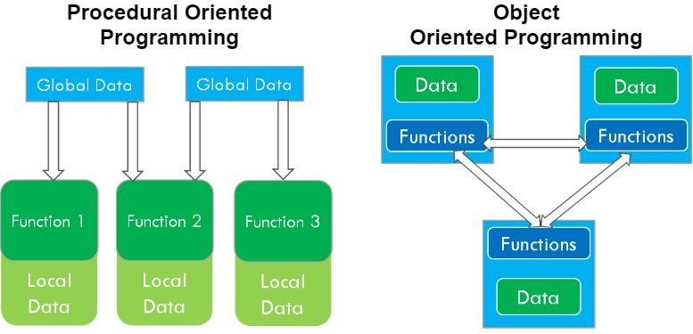
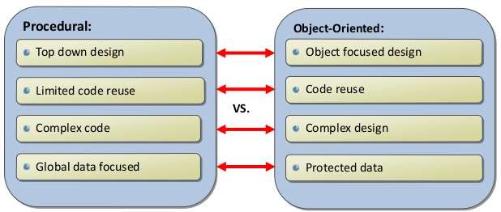
Procedural VS. Object-Oriented Programming

Slide 7
Object-oriented Programming (OOP)
Object-oriented programming approach organizes programs in a way that mirrors the real world, in which all objects are associated with both attributes and behaviors
Object-oriented programming involves thinking in terms of objects
An OOP program can be viewed as a collection of cooperating objects

Slide 8
Classes

Slide 9
Classes in OOP
Classes are constructs/templates that define objects of the same type.
A class uses Variables (data fields) to define state
A class uses Functions to define behaviors.
Additionally, a class provides a special type of function, known as constructors:
Invoked to construct objects from the class.

Slide 10
Objects in OOP
An object has a unique identity, state, and behaviors.
The state of an object consists of a set of data fields (also known as properties) with their current values.
The behavior of an object is defined by a set of functions.

Slide 11
UML Diagram for Class and Object
Notes:
The Unified Modeling Language (UML) is a general-purpose, developmental, modeling language in the field of software engineering that is intended to provide a standard way to visualize the design of a system.

Slide 12
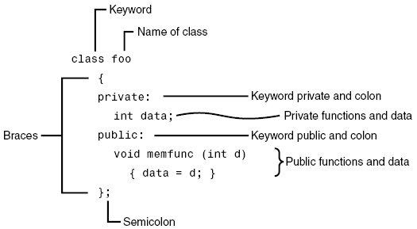
Class in C++ - Example

Slide 13
Class in C++ - Example
class
Circle
{
public
:
Note:
the special syntax for constructor
(no return type!)
// The radius of this circle
double
radius;
Data field
// Construct a circle object
Circle()
{
radius =
1
;
Constructors
}
// Construct a circle object
Circle(
double
newRadius)
{
radius = newRadius;
}
// Return th
e area of this circle
double
getArea()
Function
{
return
radius * radius *
3.14159
;
}
};

Slide 14
Class is a Type
You can use primitive data types to define variables.
You can also use class names to declare object names.
In this sense, a class is an abstract data-type or user-defined data type.

Slide 15
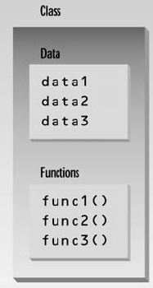
Class Data Members and Member Functions
The data items within a class are called data members or data fields or instance variables
Member functions are functions that are included within a class. Also known as instance functions.

Slide 16
Object Creation - Instantiation
In C++, you can assign a name when creating an object.
A constructor is invoked when an object is created.
The syntax to create an object using the no-arg constructor is:
ClassName objectName;
Defining objects in this way means creating them. This is also called instantiating them.

Slide 17
Object Member Access Operator
After object creation, its data and functions can be accessed (invoked) using:
The . operator, also known as the object member access operator.
objectName.dataField references a data field in the object
objectName.function( ) invokes a function on the object

Slide 18
A Simple Program – Object Creation
class Circle
{
private:
double radius;
public:
Circle()
{ radius = 5.0; }
double getArea( )
{ return radius * radius * 3.14159; }
};
C1
Object Instance
Allocate memory for radius
void main()
{
Circle C1;
//C1.radius = 10; can’t access private member outside the class
cout<<“Area of circle = “<<C1.getArea( );
}

Slide 19
Local Classes
Local classes: A local class is declared within a function definition.
A local class cannot have static data members.

Slide 20
Inline/Out-of-Line Member Functions
Inline functions:
are defined within the body of the class definition.
Out-of-line functions:
are declared within the body of the class definition and defined outside.

Slide 21
Inline/Out-of-Line Member Functions
If a member function is defined outside the class
Scope resolution operator (::) and class name are needed
Defining a function outside a class does not change it being public or private
Binary scope resolution operator (::)
Combines the class name with the member function name
Different classes can have member functions with the same name
returnType ClassName::MemberFunctionName( ){
…
}

Slide 22
Member Functions Separating Declaration from Implementation
class Circle
{
private:
double radius;
public:
Circle(double radius)
{ this->radius = radius; }
double getArea( ); // Not implemented yet
};
double Circle::getArea()
{ return this->radius * radius * 3.14159; }
Class must define a no-argument constructor too….
void main()
{
Circle C1(99.0);
cout<<“Area of circle = “<<C1.getArea();
}

Slide 23
1 // Fig. 6.3: fig06_03.cpp
2 // Time class.
3 #include <iostream>
4
5 using std::cout;
6 using std::endl;
7
8 // Time abstract data type (ADT) definition
9 class Time {
10 public:
11 Time(); // constructor
12 void setTime( int, int, int ); // set hour, minute, second
13 void printMilitary(); // print military time format
14 void printStandard(); // print standard time format
15 private:
16 int hour; // 0 – 23
17 int minute; // 0 – 59
18 int second; // 0 – 59
19 };
20
Note the :: preceding the function names.
21 // Time constructor initializes each data member to zero.
22 // Ensures all Time objects start in a consistent state.
23 Time::Time() { hour = minute = second = 0; }
24
25 // Set a new Time value using military time. Perform validity
26 // checks on the data values. Set invalid values to zero.
27 void Time::setTime( int h, int m, int s )
28 {
29 hour = ( h >= 0 && h < 24 ) ? h : 0;
30 minute = ( m >= 0 && m < 60 ) ? m : 0;
31 second = ( s >= 0 && s < 60 ) ? s : 0;
32 }

Slide 24
33
34 // Print Time in military format
35 void Time::printMilitary()
36 {
37 cout << ( hour < 10 ? "0" : "" ) << hour << ":"
38 << ( minute < 10 ? "0" : "" ) << minute;
39 }
40
41 // Print Time in standard format
42 void Time::printStandard()
43 {
44 cout << ( ( hour == 0 || hour == 12 ) ? 12 : hour % 12 )
45 << ":" << ( minute < 10 ? "0" : "" ) << minute
46 << ":" << ( second < 10 ? "0" : "" ) << second
47 << ( hour < 12 ? " AM" : " PM" );
48 }
49

Slide 25
Private Member Functions
Private Member Functions:
Only accessible (callable) from member functions of the class
No direct access possible (with object instance of the class)
Can be: inline / out-of-line

Slide 26
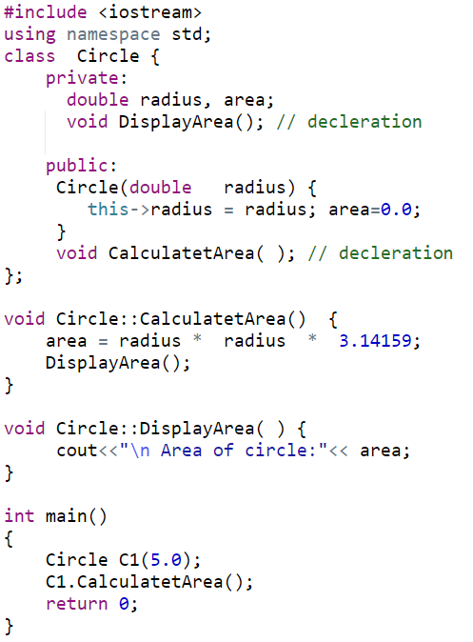
Private Member Functions (out-of-line)

Slide 27
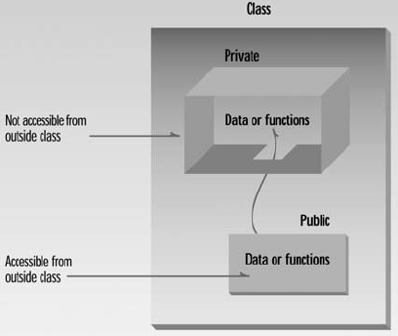
Access Modifiers/Specifier
Access modifiers are used to set access levels for variables, methods, and constructors
private, public, and protected
In C++, default accessibility is private
Notes:
A constructor can be public or private.
If there are multiple constructors of a class, then the constructor being used to construct an object must be public. Although, the constructors not being used to construct objects may still be “Private”

Slide 28
Member Access Specifiers
The default constructor (provided by compiler) is always public.
Programmer can specify a constructor to be private (no use) or public
public
Presents clients with a view of the services the class provides (i.e., interface)
Data and member functions are accessible (outside class)
private
Default access mode
Data only accessible to member functions and friends
private members only accessible through the public class interface using public member functions

Slide 29
Data Hiding - Data Field Encapsulation
A key feature of OOP is data hiding
data is concealed within a class so that it cannot be accessed mistakenly by functions outside the class.
To prevent direct modification of class attributes (outside the class), the primary mechanism for hiding data is to put it in a class and make it private using private keyword. This is also known as data field encapsulation.

Slide 30
Hidden from Whom?
Data hiding means hiding data from parts of the program that don’t need to access it. More specifically, one class’s data is hidden from other classes.
Data hiding is designed to protect well-intentioned programmers from mistakes.

Slide 31
A Simple Program – Accessing Member Function
class Circle
{
private:
double radius;
public:
Circle()
{ radius = 5.0; }
double getArea()
{ return radius * radius * 3.14159; }
};
C1
Object Instance
Allocate memory for radius
void main()
{
Circle C1;
//C1.radius = 10; can’t access private member outside the class
cout<<“Area of circle = “<<C1.getArea();
}

Slide 32
A Simple Program – Default Constructor
class Circle
{
private:
double radius;
public:
double getArea()
{ return radius * radius * 3.14159; }
};
C1
Object Instance
//Default Constructor
Circle()
{ }
// No Constructor Here
Allocate memory for radius
void main()
{
Circle C1;
//C1.radius = 10; can’t access private member outside the class
cout<<“Area of circle = “<<C1.getArea();
}

Slide 33
Object Construction with Arguments
The syntax to declare an object using a constructor with arguments is:
ClassName objectName(arguments);
For example, the following declaration creates an object named circle1 by invoking the Circle class’s constructor with a specified radius 5.5.
Circle circle1(5.5);

Slide 34
A Simple Program – Constructor with Arguments
class Circle
{
private:
double radius;
public:
Circle( ) {}
Circle(double rad)
{ radius = rad; }
double getArea()
{ return radius * radius * 3.14159; }
};
C1
Object Instance
Allocate memory for radius
void main()
{
Circle C1(9.0);
//C1.radius = 10; can’t access private member outside the class
cout<<“Area of circle = “<<C1.getArea();
}

Slide 35
Output of the following Program?
class Circle
{
private:
double radius;
public:
Circle( ) { }
Circle(double rad)
{ radius = rad; }
double getArea()
{ return radius * radius * 3.14159; }
};
void main()
{
Circle C1;
cout<<“Area of circle = “<<C1.getArea();
}
Notes:
ERROR: No Argument constructor not provided

Slide 36
const Member Functions
const Member Functions: Read-only functions cannot modify object’s data members

Slide 37
Constant Functions
class Circle
{
private:
double radius;
public:
Circle ()
{ radius = 1; }
Circle(double rad)
{ radius = rad; }
double getArea() const
{ return radius * radius * 3.14159; }
};
const member function cannot update/change object’s data
void main()
{
Circle C2(8.0);
Circle C1;
cout<<“Area of circle = “<<C1.getArea();
}

Slide 38
Accessors and Mutators(Getters & Setters)
Accessors: member function only reads/gets value from a class’s member variable but does not change it.
Mutators: member function that stores a value in member variable

Slide 39
const Objects
const Object: Read-only objects
Object data members can only be read, NO write/update of data member allowed
Requires all member functions be const (except constructors and destructors)
const object must be initialized (using constructors) at the time of object creation
Notes:
The const property of an object goes into effect after the constructor finishes executing and ends before the class's destructor executes. So the constructor and destructor can modify the object, but other methods of the class can't.
The reason for this is that the compiler cannot decide whether a method performs write operations or only read operations with data members unless additional information is supplied.

Slide 40
const Objects
const property of an object goes into effect after the constructor finishes executing and ends before the class's destructor executes
So the constructor and destructor can modify the object
Notes:
The const property of an object goes into effect after the constructor finishes executing and ends before the class's destructor executes. So the constructor and destructor can modify the object, but other methods of the class can't.
The reason for this is that the compiler cannot decide whether a method performs write operations or only read operations with data members unless additional information is supplied.

Slide 41
Pointers to Objects
You can also define pointers to class objects
You can use * and . operators OR -> to access members:

Slide 42
Pointers to Objects
Dynamic Object Creation

Slide 43
Reference to Objects
Reference is an alias to an existing object

Slide 44
Reference to Objects

Slide 45
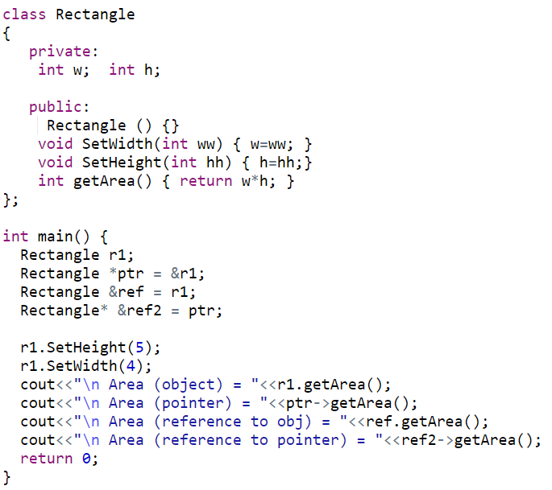
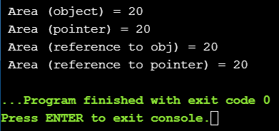
Reference and Pointers to Objects

Slide 46
Constructors and Destructors

Slide 47
Interface vs Implementation
Separating interface from implementation
Makes it easier to modify programs
Header files
Contains class definitions and function prototypes
Source-code files
Contains member function definitions

Slide 48
1 // Fig. 6.5: time1.h
2 // Declaration of the Time class.
3 // Member functions are defined in time1.cpp
4
5 // prevent multiple inclusions of header file
Dot ( . ) replaced with underscore ( _ ) in file name.
6 #ifndef TIME1_H
7 #define TIME1_H
8
If time1.h (TIME1_H) is not defined (#ifndef) then it is loaded (#define TIME1_H). If TIME1_H is already defined, then everything up to #endif is ignored.
This prevents loading a header file multiple times.
9 // Time abstract data type definition
10 class Time {
11 public:
12 Time(); // constructor
13 void setTime( int, int, int ); // set hour, minute, second
14 void printMilitary(); // print military time format
15 void printStandard(); // print standard time format
16 private:
17 int hour; // 0 - 23
18 int minute; // 0 - 59
19 int second; // 0 - 59
20 };
21
22 #endif
Notes:
#ifndef checks whether the given token has been #defined earlier in the file or in an included file; if not, it includes the code between it and the closing #else or, if no #else is present, #endif statement.

Slide 49
23 // Fig. 6.5: time1.cpp
24 // Member function definitions for Time class.
25 #include <iostream>
26
27 using std::cout;
Source file uses #include to load the header file
28
29 #include "time1.h"
30
31 // Time constructor initializes each data member to zero.
32 // Ensures all Time objects start in a consistent state.
33 Time::Time() { hour = minute = second = 0; }
34
35 // Set a new Time value using military time. Perform validity
36 // checks on the data values. Set invalid values to zero.
37 void Time::setTime( int h, int m, int s )
38 {
39 hour = ( h >= 0 && h < 24 ) ? h : 0;
40 minute = ( m >= 0 && m < 60 ) ? m : 0;
41 second = ( s >= 0 && s < 60 ) ? s : 0;
Source file contains function definitions
42 }
43
44 // Print Time in military format
45 void Time::printMilitary()
46 {
47 cout << ( hour < 10 ? "0" : "" ) << hour << ":"
48 << ( minute < 10 ? "0" : "" ) << minute;
49 }
50
51 // Print time in standard format
52 void Time::printStandard()
53 {
54 cout << ( ( hour == 0 || hour == 12 ) ? 12 : hour % 12 )
55 << ":" << ( minute < 10 ? "0" : "" ) << minute
56 << ":" << ( second < 10 ? "0" : "" ) << second
57 << ( hour < 12 ? " AM" : " PM" );
58 }

Slide 50
Constructors
A constructor is a special function used to create an object. Constructor has exactly the same name as the defining class
Constructors can be overloaded (i.e., multiple constructors with different signatures) [Purpose: making it easy to construct objects with different initial data values).
A class may be declared without constructors. In this case, a no-argument constructor with an empty body is implicitly declared in the class known as default constructor
Note: Default constructor is provided automatically only if no constructors are explicitly declared in the class.
Notes:
When you define any an argument based constructor → YOU MUST ALO DEFINE A NO-ARGUMENT constructor yourself.

Slide 51
Constructors’ Properties
must have the same name as the class itself.
do not have a return type—not even void.
play the role of initializing objects.

Slide 52
Constructors and Destructors
Constructor is a function in every class which is called when class creates its object
Basically it helps in initializing data members of the class
A class may have multiple constructors
Destructors is a function in every class which is called when the object of a class is destroyed
The main purpose of destructor is to remove dynamic memories etc.

Slide 53
Initializing Objects
Notice that default settings for the three member variables are set in constructor prototype. No names are needed; the defaults are applied in the order the variables are declared.
10 // Time abstract data type definition
11 class Time {
12 public:
13 Time( int = 0, int = 0, int = 0 ); // default constructor
14 void setTime( int, int, int ); // set hour, minute, second
15 void printMilitary(); // print military time format
16 void printStandard(); // print standard time format
17 private:
18 int hour; // 0 - 23
19 int minute; // 0 - 59
20 int second; // 0 - 59
21 };
22
23 #endif
Default Parameters in Constructor
Notes:
A constructor with « Default » parameters can be used as no argument constructor, and set of argument based constructor (1, 2, …n, argumnt based)

Slide 54
Same constructor, used in overloaded style
70
71 int main()
72 {
73 Time t1, // all arguments defaulted
74 t2(2), // minute and second defaulted
75 t3(21, 34), // second defaulted
76 t4(12, 25, 42), // all values specified
77 t5(27, 74, 99); // all bad values specified
78
79 cout << "Constructed with:\n"
80 << "all arguments defaulted:\n ";
81 t1.printMilitary();
82 cout << "\n ";
83 t1.printStandard();
84
85 cout << "\nhour specified; minute and second defaulted:"
86 << "\n ";
87 t2.printMilitary();
88 cout << "\n ";
89 t2.printStandard();
90
91 cout << "\nhour and minute specified; second defaulted:"
92 << "\n ";
93 t3.printMilitary();

Slide 55
94 cout << "\n ";
95 t3.printStandard();
96
97 cout << "\nhour, minute, and second specified:"
98 << "\n ";
99 t4.printMilitary();
100 cout << "\n ";
101 t4.printStandard();
102
103 cout << "\nall invalid values specified:"
104 << "\n ";
105 t5.printMilitary();
106 cout << "\n ";
107 t5.printStandard();
108 cout << endl;
109
110 return 0;
111 }
OUTPUT
Constructed with:
all arguments defaulted:
00:00
12:00:00 AM
hour specified; minute and second defaulted:
02:00
2:00:00 AM
hour and minute specified; second defaulted:
21:34
9:34:00 PM
hour, minute, and second specified:
12:25
12:25:42 PM
all invalid values specified:
00:00
12:00:00 AM
When only hour is specified, minute and second are set to their default values of 0.

Slide 56
Using Destructors
Destructors
Are member function of class
Perform termination housekeeping before the system reclaims the object’s memory
Name is tilde (~) followed by the class name (i.e., ~Time)
Receives no parameters, returns no value
One destructor per class (no overloading)
Destructors cannot be declared const, static
A destructor can be declared virtual or pure virtual
Notes:
const function: That cannot modify class data members
static function: class level function (not assosiated with any object)
volatile function:
virtual function: A C++ virtual function is a member function in the base class that you redefine in a derived class
pure-virtual function: A pure virtual function is a virtual function in C++ for which we need not to write any function definition and only we have to declare it

Slide 57
When Constructors and Destructors Are Called
Constructors and destructors called automatically
Order depends on scope of objects
Global scope objects
Constructors called before any other function (including main)
Destructors called when main terminates (or exit function called)
Destructors not called if program terminates with abort
Automatic local objects
Constructors called when objects are defined
Destructors called when objects leave scope
Destructors not called if the program ends with exit or abort
Notes:
Abort: Aborts the current process, producing an abnormal program termination.
exit() terminates the calling process without executing the rest code which is after the exit() function. The _Exit() function in C/C++ gives normal termination of a program without performing any cleanup tasks.

Slide 58
7 class CreateAndDestroy {
8 public:
9 CreateAndDestroy( int ); // constructor
10 ~CreateAndDestroy(); // destructor
11 private:
12 int data;
13 };
14
15 #endif

Slide 59
24
25 CreateAndDestroy::CreateAndDestroy( int value )
Constructor and Destructor changed to print when they are called.
26 {
27 data = value;
28 cout << "Object " << data << " constructor";
29 }
30
31 CreateAndDestroy::~CreateAndDestroy()
32 { cout << "Object " << data << " destructor " << endl; }

Slide 60
63
64 // Function to create objects
65 void create( void )
66 {
67 CreateAndDestroy fifth( 5 );
68 cout << " (local automatic in create)" << endl;
69
70 static CreateAndDestroy sixth( 6 );
71 cout << " (local static in create)" << endl;
72
42
73 CreateAndDestroy seventh( 7 );
43 void create( void ); // prototype
74 cout << " (local automatic in create)" << endl;
44
75 }
45 CreateAndDestroy first( 1 ); // global object
46
47 int main()
48 {
49 cout << " (global created before main)" << endl;
50
51 CreateAndDestroy second( 2 ); // local object
52 cout << " (local automatic in main)" << endl;
53
54 static CreateAndDestroy third( 3 ); // local object
55 cout << " (local static in main)" << endl;
56
57 create(); // call function to create objects
58
59 CreateAndDestroy fourth( 4 ); // local object
60 cout << " (local automatic in main)" << endl;
61 return 0;
62 }

Slide 61
OUTPUT
Object 1 constructor (global created before main)
Object 2 constructor (local automatic in main)
Object 3 constructor (local static in main)
Object 5 constructor (local automatic in create)
Object 6 constructor (local static in create)
Object 7 constructor (local automatic in create)
Object 7 destructor
Object 5 destructor
Object 4 constructor (local automatic in main)
Object 4 destructor
Object 2 destructor
Object 6 destructor
Object 3 destructor
Object 1 destructor
Notice how the order of the constructor and destructor call depends on the types of variables (automatic, global and static) they are associated with.

Slide 62
Destructor Example
void f1()
{
Employee *c = new Employee[3];
c[0].var1 = 322;
c[1].var1 = 5
c[2].var1 = 9;lete [] c; //destructor will call here
}

Slide 63
When do Constructors Get Called?
Class object creation time
Dynamically allocated object
Class argument passed by value
Class object returned by value
Object Array element (created)

Slide 64
What Constructors Do
Help in initializing: class data members
Employee( ) { id = 0; }
Allocate memory for dynamic members
Employee() { char* nameptr = new char[20];}
Allocate any needed resources
Such as to open files, etc.

Slide 65
Constructing Arrays of Objects
Complex c_arr[10];
Date date_arr[20];
Issue: There is no way to call argument-based constructors (non-default) for array members

Slide 66
Arrays of Objects and Non-Default Constructors
Trick: declare an array of pointer to objects
Allocate and initialize each object in a loop
Date *dates[31];
for (int day = 0; day < 31; ++day)
{
dates[day] = new Date(3, day, 2020);
}

Slide 67
Default Member-wise Assignment
Assignment operator (=) can be used to assign an object to another object of the same type.
Member-wise assignment: each data member of the object on the right of the assignment operator is assigned individually to the same data member in the object on the left

Slide 70
Default copy constructor
A type of constructor that is used to initialize an object with another object of the same type is known as default copy constructor.
It is by default available in all classes
syntax is ClassName(ClassName &Variable)
Notes:
If we don’t define our own copy constructor, the C++ compiler creates a default copy constructor for each class which does a member-wise copy between objects.

Slide 71
Copy Constructor for Class Date
Date::Date(Date &date)
{
// no need to check passed date arg
month = date.month;
day = date.day;
year = date.year;
}

Slide 72
Uses of the Copy Constructor
Implicitly called in 3 situations:
defining a new object from an existing object
passing an object by value
returning an object by value
Notes:
Copy constructor is called when a new object is created from an existing object, as a copy of the existing object. Assignment operator is called when an already initialized object is assigned a new value from another existing object.

Slide 73
Copy Constructor: Defining a New Object
Date d1(02,28,2020);
// init 2 local objects from d1
Date d2(d1);// pass by value
Date d3 = d1;// return value
// init a dynamic object from d1
Date* pdate = new Date(d1);
Notes:
Copy constructor is called when a new object is created from an existing object, as a copy of the existing object. Assignment operator is called when an already initialized object is assigned a new value from another existing object.

Slide 74
Copy Constructor:Passing Objects by Value
//copy constructor called for each value arg
unsigned dateDiff(Date d1, Date d2);
...
Date today;
Date d3(02, 21, 2000);
cout << dateDiff(d3, today);

Slide 75
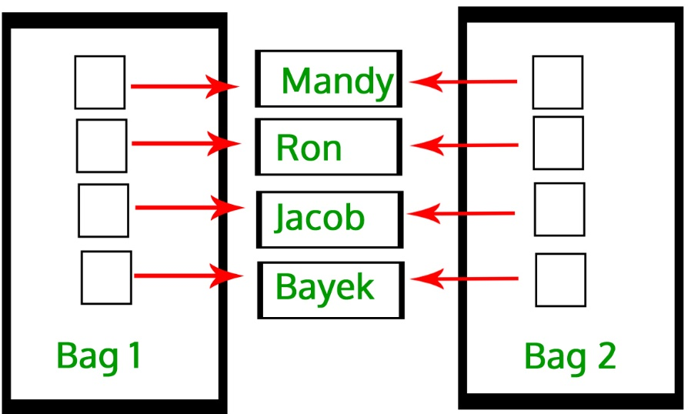
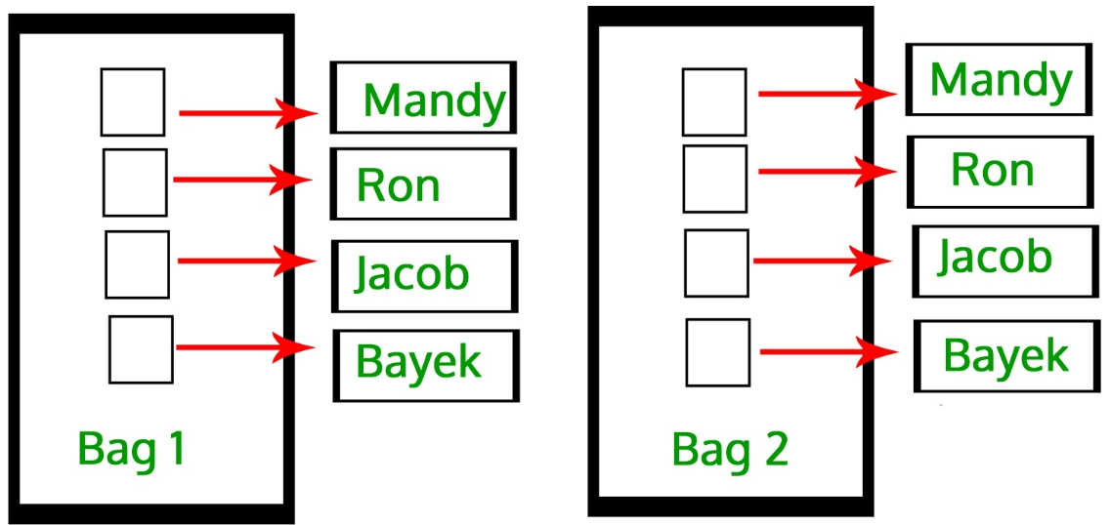
User-defined Copy Constructor, when required?
Default-copy Constructor do only “Shallow Copy”
We need user-defined copy-constructor,
When we need “Deep Copy” (for Dynamic Memory)
Notes:
Useful for dynamic memory or pointers

Slide 76
static, const, and this Pointer

Slide 77
static Class Members
static class members
Shared by all objects of a class
Efficient, when a single copy of data is enough
Only the static variable has to be updated
May seems like global variables, but have class scope
only accessible to objects of same class
Initialized at file scope
Exist even if no instances (objects) of the class exist
Both variables and functions can be static
Can be public, private or protected

Slide 78
static Class Variables
Two-Step Procedure:
Declare (Inside Class): static int radius;
Define (Outside Class): int Circle::radius=2;
static Variables
Default Initialization: 0 or Null (for pointers)
Initialization: user defined value
Initialization is made just once, at compile time.
Accessibility: Private or Public
Notes:
This external definition statement causes the variable to be created in memory and is compulsory.

Slide 79
Public static Class Variables
Can be accessed using Class name:
cout<<Employee::count;
Can be accessed via any class’ object:
cout<<e1.count;
Can be accessed via Non-Static member functions:
cout<<e1.getCount();
Can be accessed via Static member functions:
cout<<Employee::Stat_getCount(); cout<<e1.Stat_getCount(); //public static
Notes:
There is no this pointer for static functions, they exist independent of objects
However, sharing variables across object instances and making variables accessible are independent of each other. There are four combinations of (shared, accessible) pairs. All four are available to you:
public static variable is shared and accessible outside the class
private static variable is shared, but not accessible outside the class
public non-static variable is not shared, but accessible outside the class
private non-static variable is neither shared nor accessible outside the class

Slide 80
Private static Class Variables
Cannot be accessed using Class name:
// ERROR → cout<<Employee::count;
Cannot be accessed via class' object:
// ERROR → cout<<e1.count;
Can be accessed via Non-Static member functions:
cout<<e1.getCount();
Can be accessed via Static member functions:
cout<<Employee::Stat_getCount(); cout<<e1.Stat_getCount(); //public static
Notes:
There is no this pointer for static functions, they exist independent of objects
However, sharing variables across object instances and making variables accessible are independent of each other. There are four combinations of (shared, accessible) pairs. All four are available to you:
public static variable is shared and accessible outside the class
private static variable is shared, but not accessible outside the class
public non-static variable is not shared, but accessible outside the class
private non-static variable is neither shared nor accessible outside the class

Slide 81
static Class Functions
Non-static function:
Can access: static/non-static data members and static/non-static methods
Static functions:
Can access: static data and static functions
Cannot access: non-static data, non-static functions, and this pointer

Slide 82
Public static Class Functions
Can be invoked using class’s any object:
cout<<e1.getCount();
Can be invoked using Class name:
cout<<Employee::getCount();

Slide 83
Private static Class Functions
Cannot be invoked using class’s object
//ERROR → cout<<e1.getCount();
Cannot be invoked using Class name
//ERROR → cout<<Employee::getCount();
Can be invoked within Class:
Static member functions
Non-Static member functions

Slide 84
1 // Fig. 7.9: employ1.h
2 // An employee class
3 #ifndef EMPLOY1_H
4 #define EMPLOY1_H
5
6 class Employee {
7 public:
8 Employee( const char*, const char* ); // constructor
9 ~Employee(); // destructor
10 const char *getFirstName() const; // return first name
11 const char *getLastName() const; // return last name
12
13 // static member function
14 static int getCount(); // return # objects instantiated
15
16 private:
static member function and variable declared.
17 char *firstName;
18 char *lastName;
19
20 // static data member
21 static int count; // number of objects instantiated
22 };
23
24 #endif

Slide 85
25 // Fig. 7.9: employ1.cpp
26 // Member function definitions for class Employee
27 #include <iostream>
28
29 using std::cout;
30 using std::endl;
static data member count and function getCount( ) initialized at file scope (required).
31
32 #include <cstring>
33 #include <cassert>
34 #include "employ1.h"
35
36 // Initialize the static data member
37 int Employee::count = 0;
38
39 // Define the static member function that
40 // returns the number of employee objects instantiated.
41 int Employee::getCount() { return count; }
Note the use of assert to test for memory allocation.
42
43 // Constructor dynamically allocates space for the
44 // first and last name and uses strcpy to copy
45 // the first and last names into the object
46 Employee::Employee( const char *first, const char *last )
47 {
48 firstName = new char[ strlen( first ) + 1 ];
49 assert( firstName != 0 ); // ensure memory allocated
static data member count changed when a constructor/destructor called.
50 strcpy( firstName, first );
51
52 lastName = new char[ strlen( last ) + 1 ];
53 assert( lastName != 0 ); // ensure memory allocated
54 strcpy( lastName, last );
55
56 ++count; // increment static count of employees
Notes:
Assertions are statements used to test assumptions made by programmer. For example, we may use assertion to check if pointer returned by malloc() is NULL or not.
Following is syntax for assertion.
void assert( int expression ); If expression evaluates to 0 (false), then the expression, sourcecode filename, and line number are sent to the standard error, and then abort() function is called., Otherwise moves to next statement

Slide 86
57 cout << "Employee constructor for " << firstName
58 << ' ' << lastName << " called." << endl;
59 }
60
61 // Destructor deallocates dynamically allocated memory
62 Employee::~Employee()
static data member count changed when a constructor/destructor called.
63 {
64 cout << "~Employee() called for " << firstName
65 << ' ' << lastName << endl;
66 delete [] firstName; // recapture memory
Count decremented because of destructor calls from delete.
67 delete [] lastName; // recapture memory
68 --count; // decrement static count of employees
69 }
70
71 // Return first name of employee
72 const char *Employee::getFirstName() const
73 {
74 // Const before return type prevents client from modifying
75 // private data. Client should copy returned string before
76 // destructor deletes storage to prevent undefined pointer.
77 return firstName;
78 }
79
80 // Return last name of employee
81 const char *Employee::getLastName() const
82 {
83 // Const before return type prevents client from modifying
84 // private data. Client should copy returned string before
85 // destructor deletes storage to prevent undefined pointer.
86 return lastName;
87 }

Slide 87
88 // Fig. 7.9: fig07_09.cpp
89 // Driver to test the employee class
90 #include <iostream>
If no Employee objects exist getCount must be accessed using the class name and (::).
91
count incremented because of constructor calls from new.
92 using std::cout;
93 using std::endl;
94
95 #include "employ1.h"
96
Number of employees before instantiation is 0
97 int main()
98 {
99 cout << "Number of employees before instantiation is "
100 << Employee::getCount() << endl; // use class name
e2Ptr->getCount() or Employee::getCount() would also work.
101
102 Employee *e1Ptr = new Employee( "Susan", "Baker" );
103 Employee *e2Ptr = new Employee( "Robert", "Jones" );
104
Number of employees after instantiation is 2
105 cout << "Number of employees after instantiation is "
106 << e1Ptr->getCount();
107
Employee constructor for Susan Baker called.
Employee constructor for Robert Jones called.
108 cout << "\n\nEmployee 1: "
109 << e1Ptr->getFirstName()
110 << " " << e1Ptr->getLastName()
Employee 1: Susan Baker
Employee 2: Robert Jones
111 << "\nEmployee 2: "
112 << e2Ptr->getFirstName()
113 << " " << e2Ptr->getLastName() << "\n\n";
114
115 delete e1Ptr; // recapture memory
~Employee() called for Susan Baker
~Employee() called for Robert Jones
116 e1Ptr = 0;
117 delete e2Ptr; // recapture memory
118 e2Ptr = 0;

Slide 88
119
120 cout << "Number of employees after deletion is "
121 << Employee::getCount() << endl;
122
123 return 0;
count back to zero.
124 }
Number of employees before instantiation is 0
Employee constructor for Susan Baker called.
Employee constructor for Robert Jones called.
Number of employees after instantiation is 2
Employee 1: Susan Baker
Employee 2: Robert Jones
~Employee() called for Susan Baker
~Employee() called for Robert Jones
Number of employees after deletion is 0

Slide 89
const Class Members
As with member functions, data members can also be const
Member Initializer List:
Can be used to initialize both const and non-const data members
consts and references must be initialized using member initializer

Slide 90
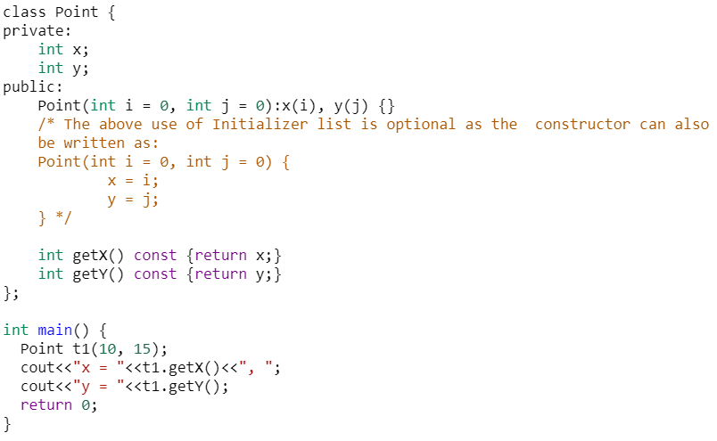
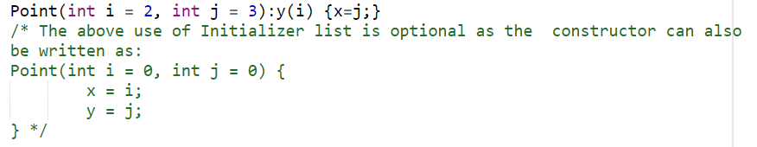
Member Initializer List (Non-const Members)
Notes:
OUTPUT:
x = 10, y = 15

Slide 91
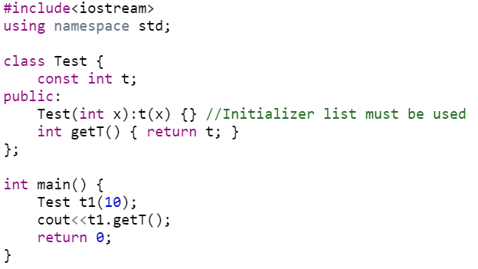
Member Initializer List (non-static const)
Notes:
OUTPUT: 10

Slide 92
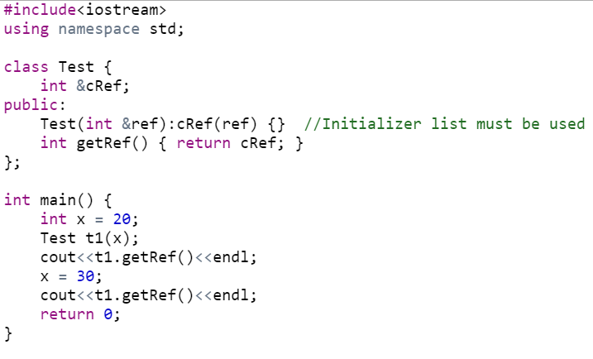
Member Initializer List (References)
Notes:
OUTPUT:
20
30
NOT: IF refrence variable is not initializaed in initialization list and intitliazed within constructor, we get an error message

Slide 93
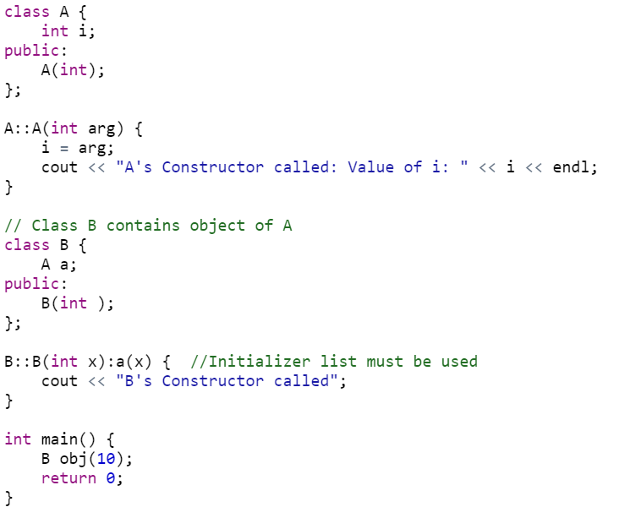
Member Initializer List (member object, no default constructor)
Notes:
OUTPUT:
A's Constructor called: Value of i: 10
B's Constructor called

Slide 94
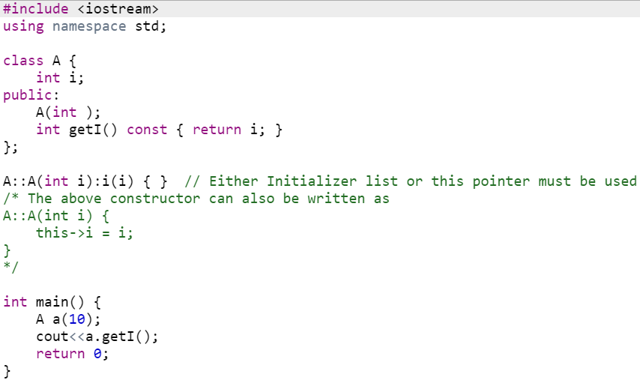
Member Initializer List (parameter name same as data member)
Notes:
OUTPUT:
10

Slide 95
Member Initializer List (base class members)
Will be discussed in chapters after midterm
Notes:
https://www.geeksforgeeks.org/when-do-we-use-initializer-list-in-c/

Slide 96
The this Pointer
this keyword is a special built-in pointer (constant pointer) that references to the calling object.
this pointer is passed as a hidden argument to all non-static member function and is available as a local variable within the body of all non-static functions.
Not part of the object itself (this pointer is not reflected with sizeof(object))
Can be used to access instance variables within constructors and member functions
Notes:
C++ this Pointer. Every object in C++ has access to its own address through an important pointer called this pointer. The this pointer is an implicit parameter to all member functions. Therefore, inside a member function, this may be used to refer to the invoking object.

Slide 97
Using the this Pointer
Examples using this
For a member function print data member x, either
this->x;
or
(*this).x
Cascaded member function calls:
Function returns a reference pointer to the same object
{ return *this; }
Other functions can operate on that pointer

Slide 98
Using the this Pointer
Example of cascaded member function calls:
Member functions setHour, setMinute, and setSecond all return *this (reference to an object)
For object t, consider:
t.setHour(1).setMinute(2).setSecond(3);
Executes t.setHour(1), returns *this (reference to object) and the expression becomes
t.setMinute(2).setSecond(3);
Executes t.setMinute(2), returns reference and becomes
t.setSecond(3);
Executes t.setSecond(3), returns reference and becomes
t; (Has no effect)

Slide 99
1 // Fig. 7.7: fig07_07.cpp
2 // Using the this pointer to refer to object members.
3 #include <iostream>
4
5 using std::cout;
6 using std::endl;
7
8 class Test {
9 public:
10 Test( int = 0 ); // default constructor
11 void print() const;
12 private:
Printing x directly.
13 int x;
14 };
15
16 Test::Test( int a ) { x = a; } // constructor
17
18 void Test::print() const // ( ) around *this required
Print x using the arrow -> operator off the this pointer.
19 {
20 cout << " x = " << x
21 << "\n this->x = " << this->x
22 << "\n(*this).x = " << ( *this ).x << endl;
23 }
24
25 int main()
26 {
27 Test testObject( 12 );
Printing x using the dot (.) operator. Parenthesis required because dot operator has higher precedence than *. Without, interpreted incorrectly as *(this.x).
28
29 testObject.print();
30
31 return 0;
32 }

Slide 100
x = 12
this->x = 12
(*this).x = 12
All three methods have the same result.

Slide 101
1 // Fig. 7.8: time6.h
2 // Cascading member function calls.
3
4 // Declaration of class Time.
5 // Member functions defined in time6.cpp
6 #ifndef TIME6_H
7 #define TIME6_H
8
9 class Time {
10 public:
11 Time( int = 0, int = 0, int = 0 ); // default constructor
12
13 // set functions
14 Time &setTime( int, int, int ); // set hour, minute, second
15 Time &setHour( int ); // set hour
16 Time &setMinute( int ); // set minute
17 Time &setSecond( int ); // set second
Notice the Time & - function returns a reference to a Time object.
Specify object in function definition.
18
19 // get functions (normally declared const)
20 int getHour() const; // return hour
21 int getMinute() const; // return minute
22 int getSecond() const; // return second
23
24 // print functions (normally declared const)
25 void printMilitary() const; // print military time
26 void printStandard() const; // print standard time
27 private:
28 int hour; // 0 - 23
29 int minute; // 0 - 59
30 int second; // 0 - 59
31 };
32
33 #endif

Slide 102
34 // Fig. 7.8: time.cpp
35 // Member function definitions for Time class.
36 #include <iostream>
37
38 using std::cout;
39
40 #include "time6.h"
41
42 // Constructor function to initialize private data.
43 // Calls member function setTime to set variables.
44 // Default values are 0 (see class definition).
45 Time::Time( int hr, int min, int sec )
46 { setTime( hr, min, sec ); }
47
48 // Set the values of hour, minute, and second.
Returning *this enables cascading function calls
49 Time &Time::setTime( int h, int m, int s )
50 {
51 setHour( h );
52 setMinute( m );
53 setSecond( s );
54 return *this; // enables cascading
55 }
56
57 // Set the hour value
58 Time &Time::setHour( int h )
59 {
60 hour = ( h >= 0 && h < 24 ) ? h : 0;
61
62 return *this; // enables cascading
63 }
64

Slide 103
65 // Set the minute value
66 Time &Time::setMinute( int m )
67 {
68 minute = ( m >= 0 && m < 60 ) ? m : 0;
69
70 return *this; // enables cascading
71 }
72
73 // Set the second value
Returning *this enables cascading function calls
74 Time &Time::setSecond( int s )
75 {
76 second = ( s >= 0 && s < 60 ) ? s : 0;
77
78 return *this; // enables cascading
79 }
80
81 // Get the hour value
82 int Time::getHour() const { return hour; }
83
84 // Get the minute value
85 int Time::getMinute() const { return minute; }
86
87 // Get the second value
88 int Time::getSecond() const { return second; }
89
90 // Display military format time: HH:MM
91 void Time::printMilitary() const
92 {
93 cout << ( hour < 10 ? "0" : "" ) << hour << ":"
94 << ( minute < 10 ? "0" : "" ) << minute;

Slide 104
95 }
96
97 // Display standard format time: HH:MM:SS AM (or PM)
printStandard does not return a reference to an object.
98 void Time::printStandard() const
99 {
100 cout << ( ( hour == 0 || hour == 12 ) ? 12 : hour % 12 )
101 << ":" << ( minute < 10 ? "0" : "" ) << minute
102 << ":" << ( second < 10 ? "0" : "" ) << second
103 << ( hour < 12 ? " AM" : " PM" );
104 }
105 // Fig. 7.8: fig07_08.cpp
106 // Cascading member function calls together
107 // with the this pointer
108 #include <iostream>
Notice cascading function calls.
109
110 using std::cout;
111 using std::endl;
112
113 #include "time6.h"
114
115 int main()
116 {
117 Time t;
118
119 t.setHour( 18 ).setMinute( 30 ).setSecond( 22 );
Cascading function calls. printStandard must be called after setTime because printStandard does not return a reference to an object.
t.printStandard().setTime(); would cause an error.
120 cout << "Military time: ";
121 t.printMilitary();
122 cout << "\nStandard time: ";
123 t.printStandard();
124
125 cout << "\n\nNew standard time: ";
126 t.setTime( 20, 20, 20 ).printStandard();

Slide 105
127 cout << endl;
128
129 return 0;
130 }
Military time: 18:30
Standard time: 6:30:22 PM
New standard time: 8:20:20 PM

Slide 106
What is the Singleton Pattern?
Software design pattern is a general, reusable solution to a commonly occurring problem within a given context in software design.
The Singleton pattern ensures that a class is only instantiated once and provides a global access point for this instance

Slide 107
Why use the Singleton Pattern?
It is important for some classes to only have one instance
It is also important that this single instance is easily accessible
Why not use a global object?
Global variables make objects accessible, but they don't prevent the instantiation of multiple objects.

Slide 108
Solution
Make the class responsible for keeping track of its only instance:
The class can ensure that no other instances are created
This is the Singleton pattern

Slide 109
Examples of Singleton Patterns
HR Manager
Head of Department
Print spooler
Window Managers
Digital Filters
Accounting Systems
…

Slide 110
Design Solution
Defines a getInstance( ) operation that lets clients access its unique instance
Responsible for creating its own unique instance
Singleton
-static uniqueinstance
Singleton data
-Singleton()
+static getInstance()
Singleton methods…
…
return uniqueinstance;

Slide 111
Implementation
Declare all of class’s constructors private
prevent other classes from directly creating an instance of this class
Hide the operation that creates the instance behind a class operation (getInstance)
Variation: Since creation policy is encapsulated in getInstance, it is possible to vary the creation policy

Slide 112
Singleton Example (C++)
class Database
{
private:
static Database *DB;
...
//private constructor
Database() { ... }
public:
//static method
static Database *getDB()
{
if (DB == NULL)
DB = new Database());
return DB;
}
...
};
Database* Database::DB=NULL;
In application code…
Database *db = Database.getDB();
db->someMethod();
Notes:
If we implement a destructor, it should also be static

Slide 113
Singleton Consequences
Ensures only one (e.g., Database) instance exists in the system
Can maintain a pointer (need to create object on first get call) or an actual object
Can also use this pattern to control fixed multiple instances
Much better than the alternative: global variables
Notes:
Fixed set of instances can also be created by making constructors private and getting instance of a class via static method (set of static variables or static array of objects.

